Slide 1

Inventory Levels Analysis
Uncovering insights into supply chain movement and item stocks across departmental store locations

Slide 2
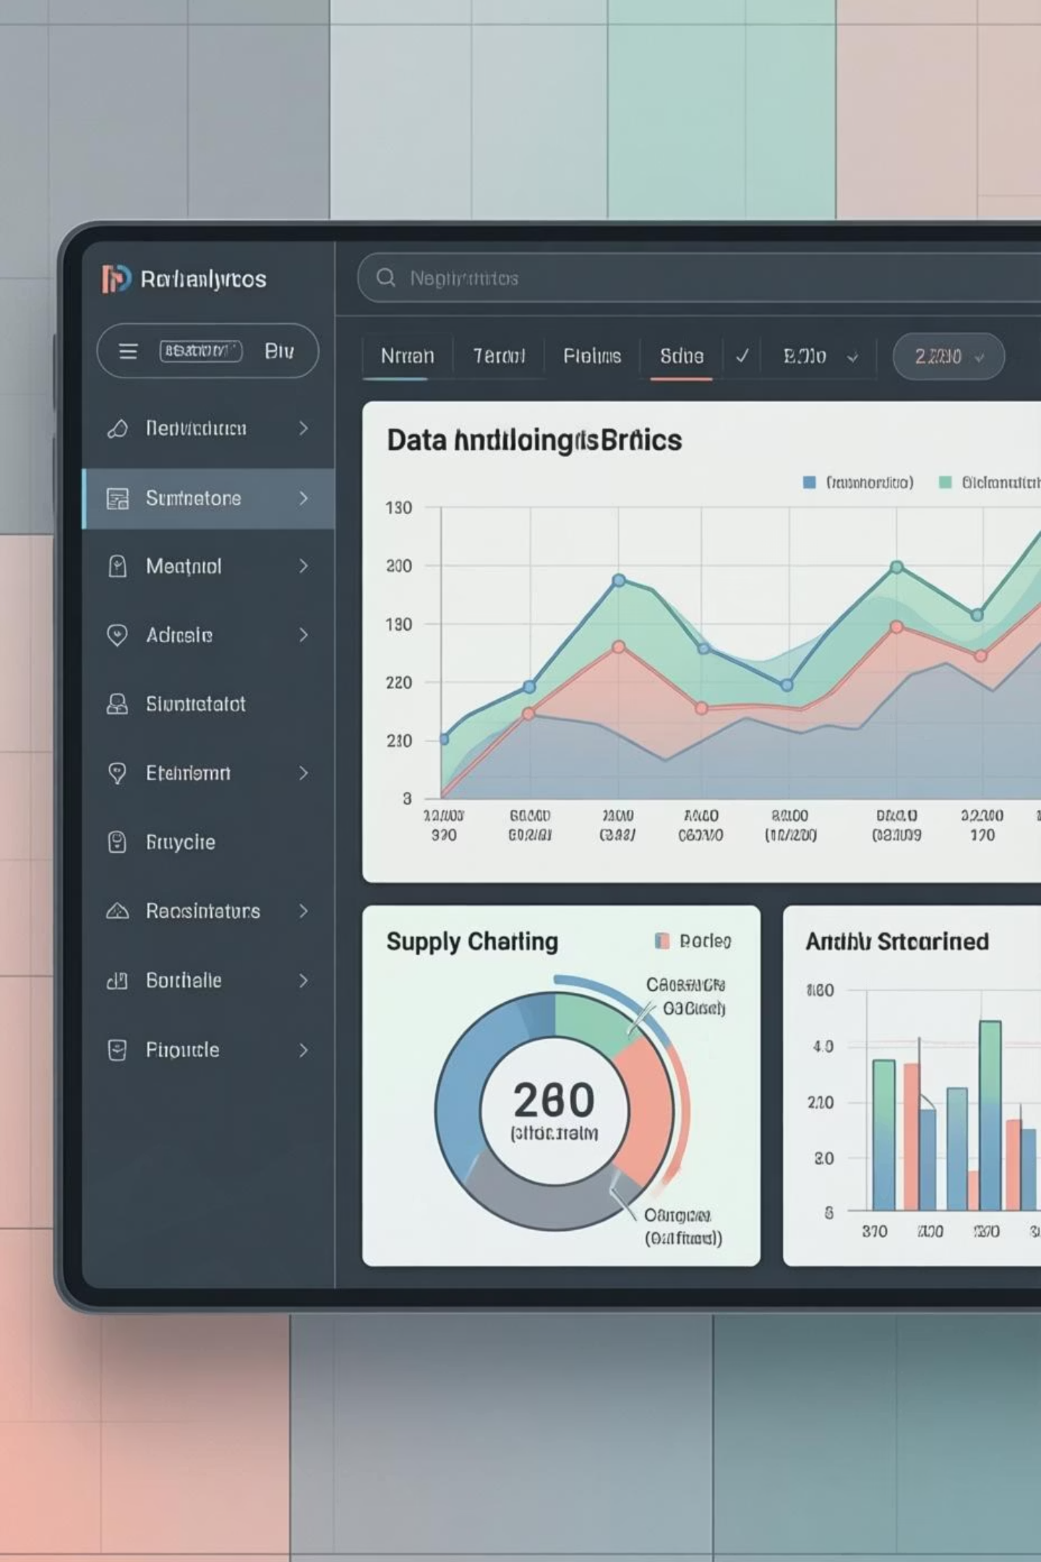

PROJECT OVERVIEW
Supply Chain Movement Analysis
Data Source
Primary Goal
Transactional data from departmental store operations
Uncover insights into item stocks per branch, city, and location
Analysis Approach
Multi-tool analysis using Python and MySQL

Slide 3
DATASET
Dataset Summary
11,772
21
37
Total Rows
Columns
Missing Values
Comprehensive transaction records
Rich feature set for analysis
In min stock and max stock fields
Location Demographics
Stock Details
Location name
Max stock
Branch name
Min stock
District name
Warehouse
Total stock

Slide 4

PYTHON ANALYSIS
Exploratory Data Analysis
01
02
Data Loading
Initial Exploration
Imported dataset using pandas library
Used df.info() for structure, df.describe() for summary statistics
03
Missing Data Handling
Checked null values, imputed missing min/max stocks with median values

Slide 5
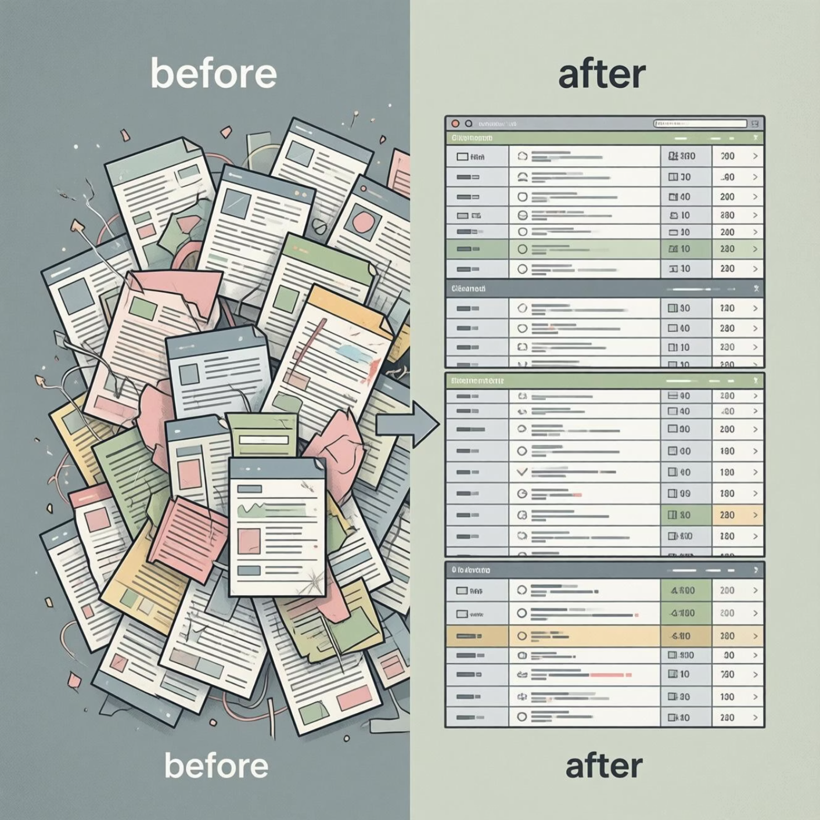
Data Preparation Process
Data Quality Check
Identified 37 missing values in critical stock fields
Imputation Strategy
Replaced missing values with median to maintain data integrity
Structure Analysis
Statistical Summary
df.info() revealed dataset composition and data types
df.describe() provided key metrics and distributions

Slide 6


MYSQL
Database Analysis Setup
Server
Database
Schema
MySQL
more (departmental store)
chain (table)
Performed structured analysis in MySQL to answer key questions related to supply chain movement

Slide 7
Key SQL Analysis Questions
1
Stock Distribution
Analyzed inventory levels across locations
2
Branch Performance
Compared stock metrics by branch
3
Warehouse Utilization
Evaluated storage capacity and usage
4
District Trends
Identified patterns across districts
5
Stock Variance
Examined min/max stock relationships

Slide 8
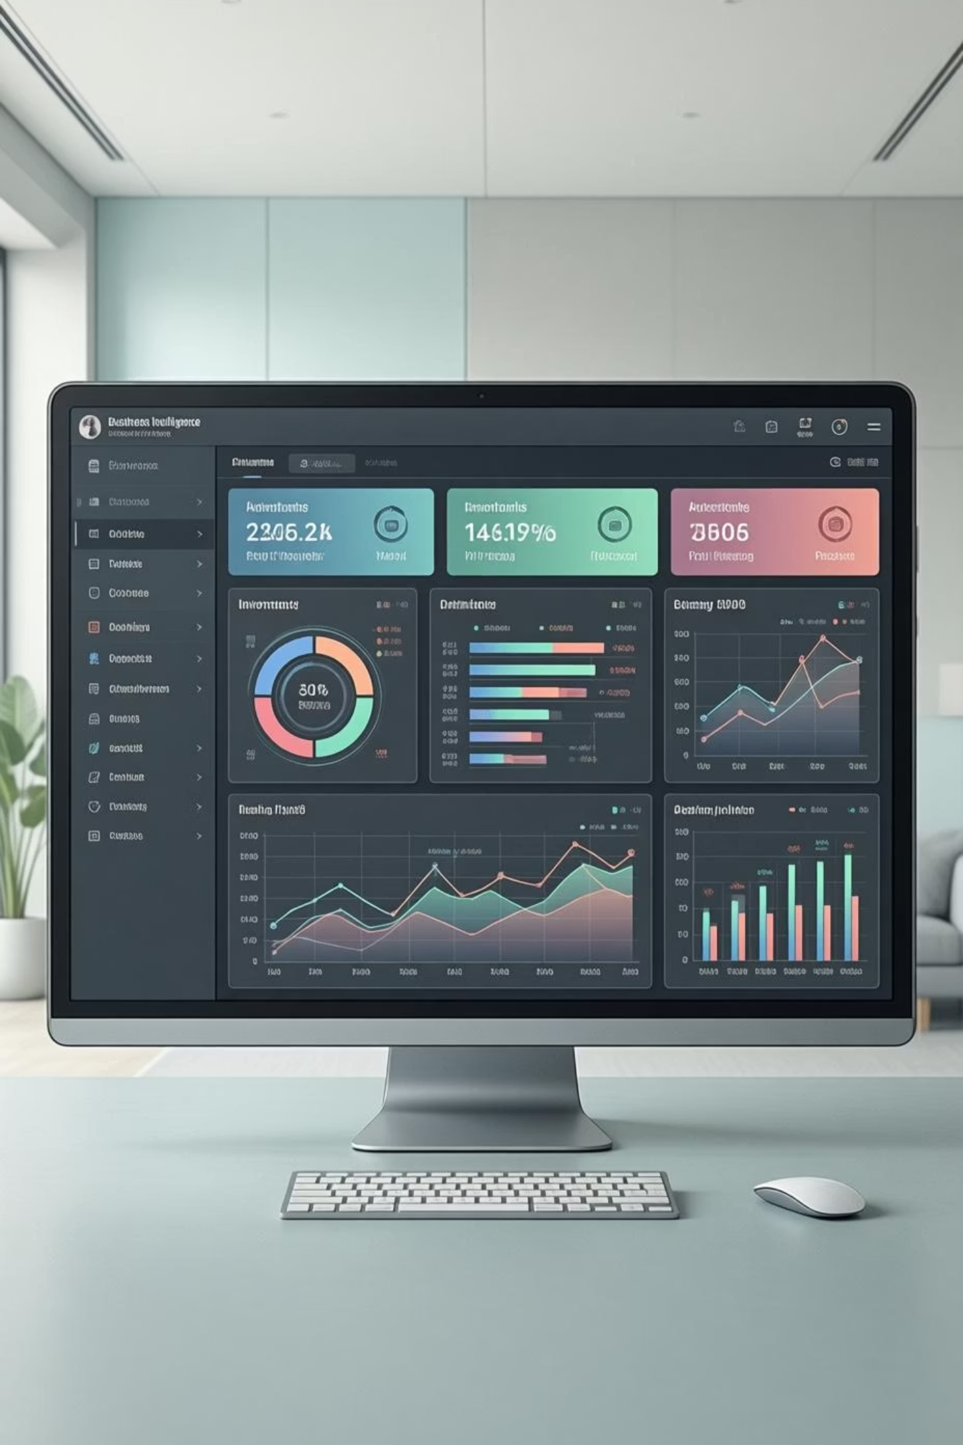
DASHBOARD
Inventory Levels Dashboard
Comprehensive visualization of stock levels, branch performance, and supply chain metrics
Location Insights
Stock distribution across branches and districts
Performance Metrics
Real-time tracking of inventory levels

Slide 9

RECOMMENDATIONS
Key Recommendations
Stock Invariance
1
Max and min stock levels must be separate with no common numbers to ensure proper inventory management
Item Description
2
Descriptions must be neat, clear, and visible—not clumsy or confusing
Total Stock Accuracy
3
Total stock calculations must be accurate and validated across all locations

Slide 10




Next Steps
Implement Changes
Apply recommendations to improve data quality
Monitor Progress
Track improvements in inventory accuracy
Scale Insights
Expand analysis to additional locations
Data-driven inventory management leads to optimized supply chain performance

